Slide 1
Lab Meeting
08/28/2024, 최준명

Slide 2
Index
Paper review
Implementation Analysis
Experiment
Further research

Slide 3
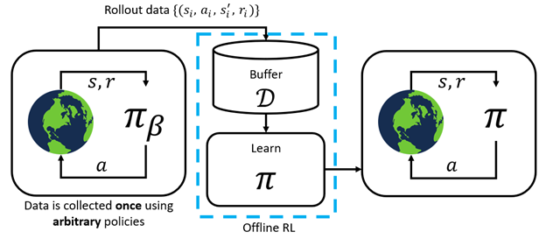
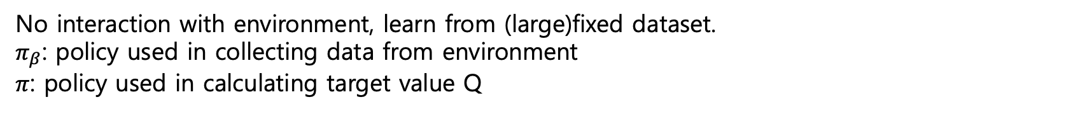
1. Paper review
- Offline RL
No interaction with environment, learn from (large)fixed dataset.
$π_{β}$: policy used in collecting data from environment
$π$: policy used in calculating target value Q
image: https://towardsdatascience.com/the-power-of-offline-reinforcement-learning-5e3d3942421c
Notes:
반대로 offline RL은 실제 환경과의 상호작용 없이, 이미 얻어진 큰 데이터셋을 기반으로 학습한다.
이때 이 데이터셋을 수집한 policy는 learning하는 policy와 다를 수 있고, 아예 policy 없이 사람이 action을 취한 결과일 수도 있다.
따라서 pi_beta로 learned policy pi와 다르게 표기한다.

Slide 4
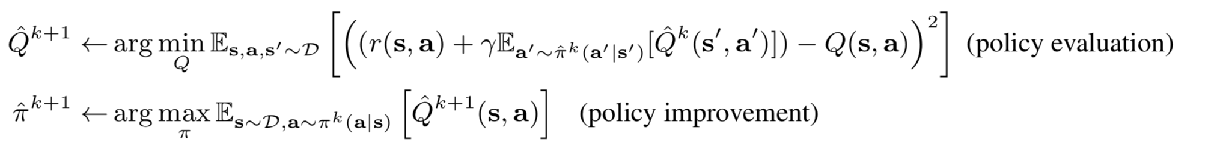
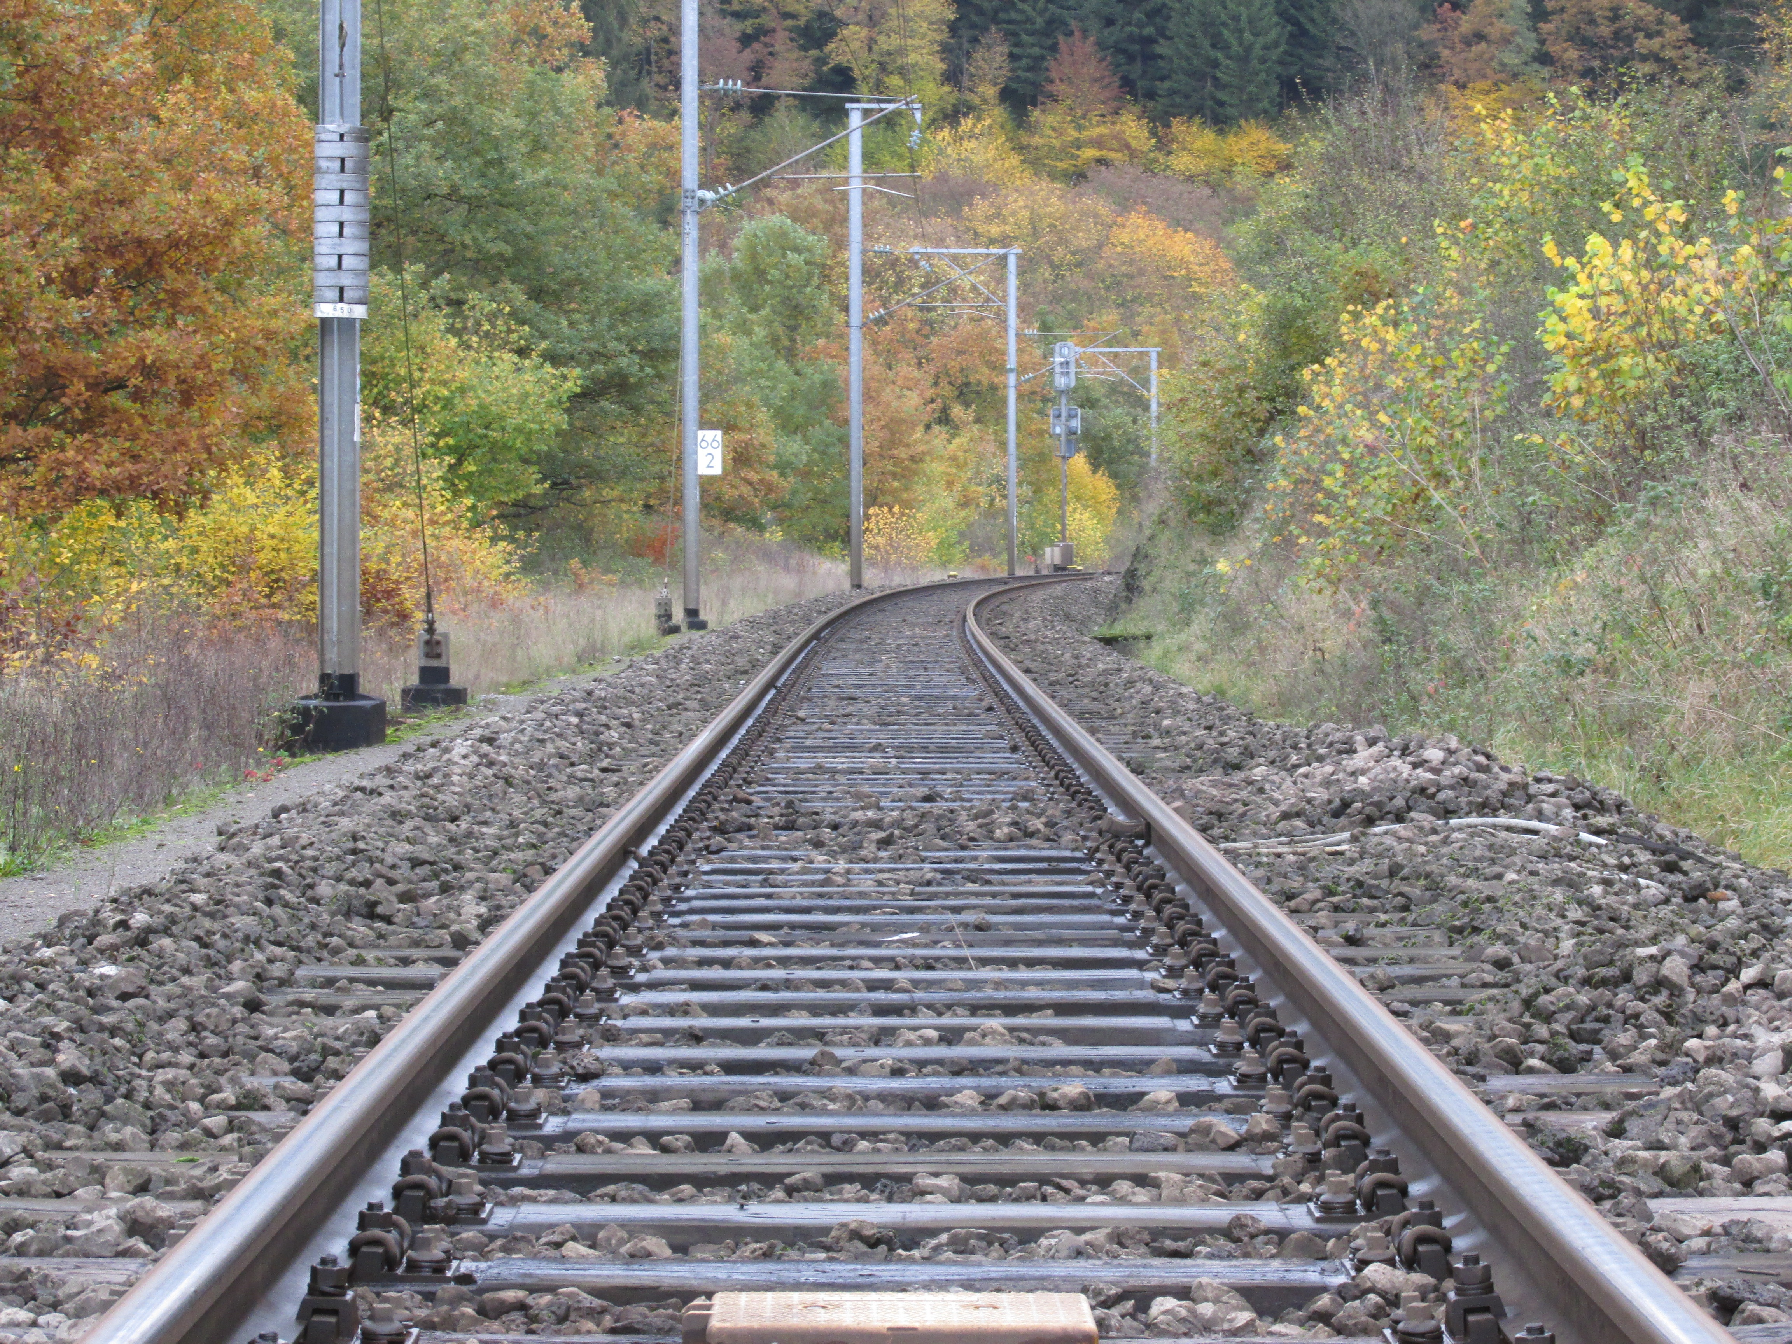
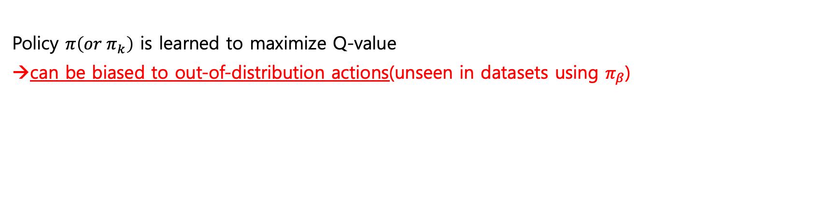
1. Paper review
- Problem: Distributional Shift
Policy $π\left(or π_{k}\right)$ is learned to maximize Q-value
can be biased to out-of-distribution actions(unseen in datasets using $π_{β}$)
Offline Reinforcement Learning: Tutorial, Review, and Perspectives on Open Problems – Sergey Levine et el. (2020)
Notes:
이 논문에서 해결하고자 하는 주요한 문제인 distributional shift는 바로 이 Pi 와 pi_beta의 차이에서 기인한다.
policy evaluation과 improvement 에서는 그저 value function Q를 maximize하는 policy를 찾기 때문에, pi_beta에서 보지 못했던, 즉 out-of-distribution action에 대해서 높은 Q를 가질 확률이 크고, 그렇게 되면 이러한 행동을 선택할 확률이 높아진다, 즉 편향된다는 것.
예를 들어 사람이 직접 돌아다니며 수집한 데이터셋이 있는데, 이 사람이 선로에 들어간 적이 없다면 선로에 들어가는 행동을 높은 Q value로 낙관적으로 평가할 수 있고, 잘못된 policy 학습으로 이어질 수 있음.

Slide 5
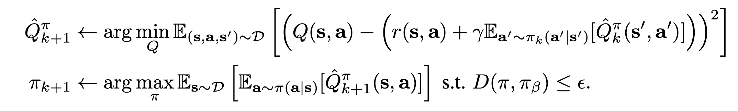
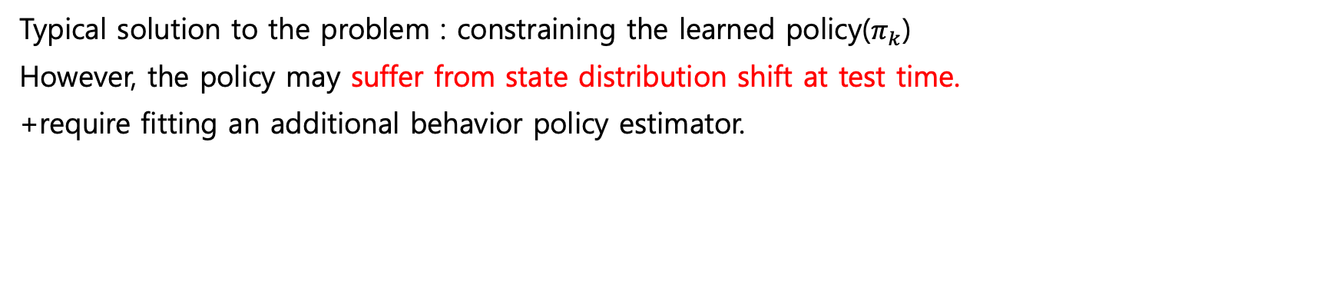
1. Paper review
- Problem: Distributional Shift
Offline Reinforcement Learning: Tutorial, Review, and Perspectives on Open Problems – Sergey Levine et el. (2020)
Typical solution to the problem : constraining the learned policy($π_{k}$)
However, the policy may suffer from state distribution shift at test time.
+require fitting an additional behavior policy estimator.
Notes:
이전의 offline RL 연구에서는 이 문제를 learned policy를 제약을 거는 것으로 해결하려 했다.
하지만 저자는 이러한 방법은 근본적인 원인을 해결한 것이 아니므로 실제 test를 할 때 문제가 발생할 수 있으며, 또한 pi_k를 추정하는 estimator를 추가해야 돼서 알고리즘이 복잡해진다고 주장한다.

Slide 6
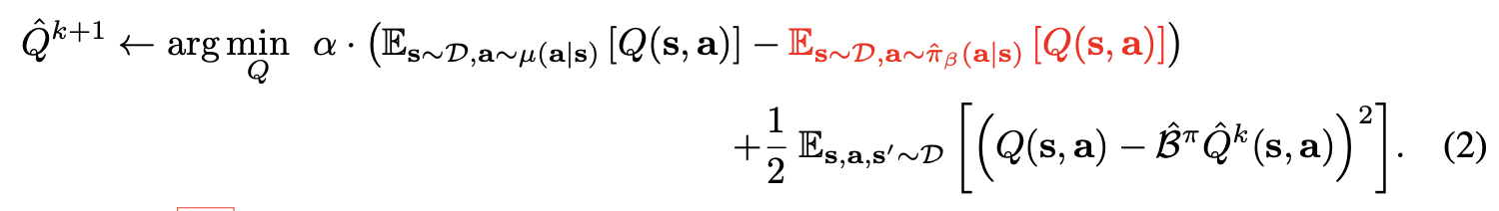
1. Paper review
- Conservative Off-Policy Evaluation
Q-value maximization term
To minimize ‘blue’, we have to maximize second expectation(red one)
maximize Q for actions in$π_{β}^$ (in-distribution, seen actions)
penalizes penalties of overestimation
However, $^Q^{π}$ might not lower-bound $Q^{π}$ pointwise in this method.
Notes:
policy evaluation 에 이 Q-value maximization term 을 추가함으로써 true Q를 tight하게 bound할 수 있음을 보였고

Slide 7
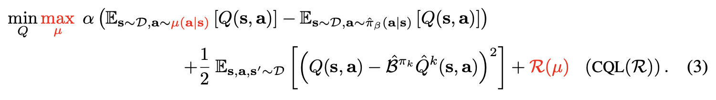
1. Paper review
- Conservative Q-Learning for Offline RL
Alternating between policy evaluation and improvement is computationally expensive.
Instead, choose $μ$ to approximate the policy that maximize Q-function iterate.
+ Added regularizer $ℛ(μ)$ and denoted by $CQL(ℛ)$.
Property of CQL varies depending on this regularizer
Notes:
여기에 policy improvement를 동시에 진행하면서 regularlizer까지 추가한 게 CQL이었다.

Slide 8
1. Paper review
- Conservative Q-Learning for Offline RL
If we choose $ℛ\left(μ\right)$ to be KL-divergence against prior $ρ\left(a | s\right)$,
we get $μ\left(a | s\right)∝ρ\left(a | s\right)∙\exp\left(Q\left(s,a\right)\right).$
First, if prior $ρ=unif(a)$, equation (3) becomes,
This is called $CQL(ℋ)$.
Notes:
이때 prior를 uniform으로 선택하면 CQL(H).

Slide 9
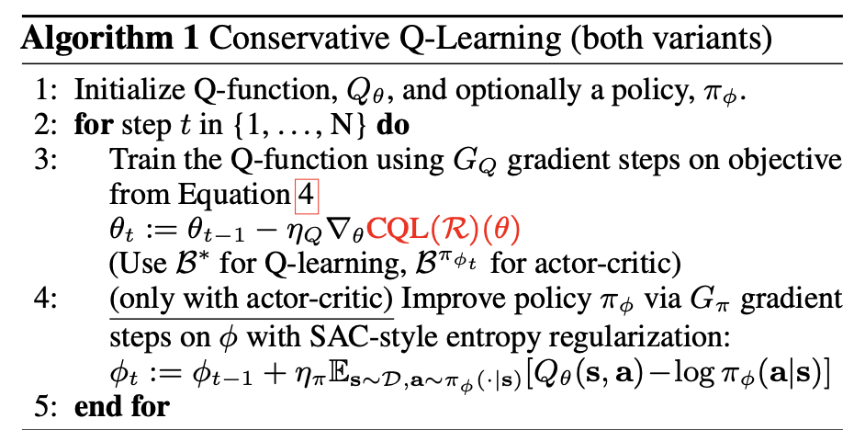
1. Paper review
- Pseudocode

Slide 10
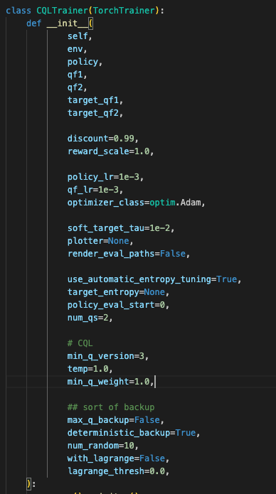
2. Implementation Analysis
- Initialization

Slide 11
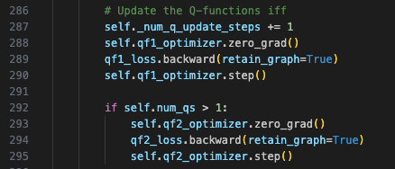
2. Implementation Analysis
- Q-function Update
Use gradient descent on ‘qf1_loss’
→ How is ‘qf1_loss’ defined?

Slide 12
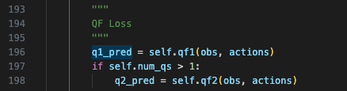
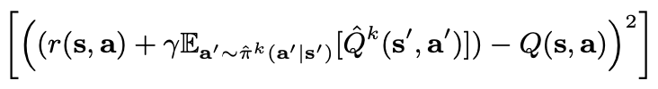
2. Implementation Analysis
- Policy Evaluation
→ q_target

Slide 13

2. Implementation Analysis
- Policy Evaluation
→MSE of q_target and q_pred

Slide 14
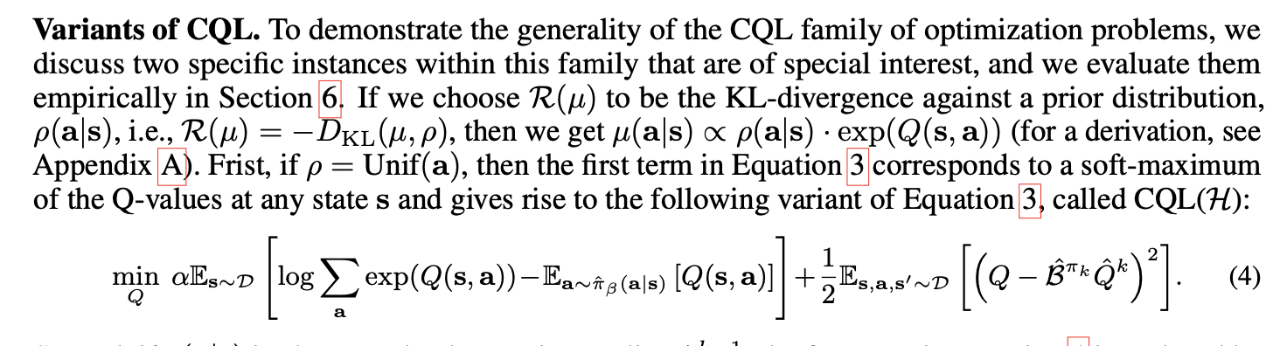
2. Implementation Analysis
- CQL

Slide 15
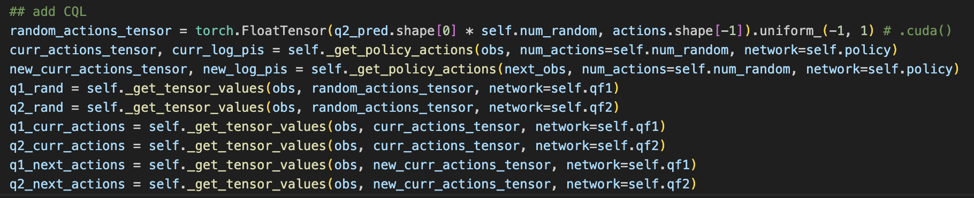
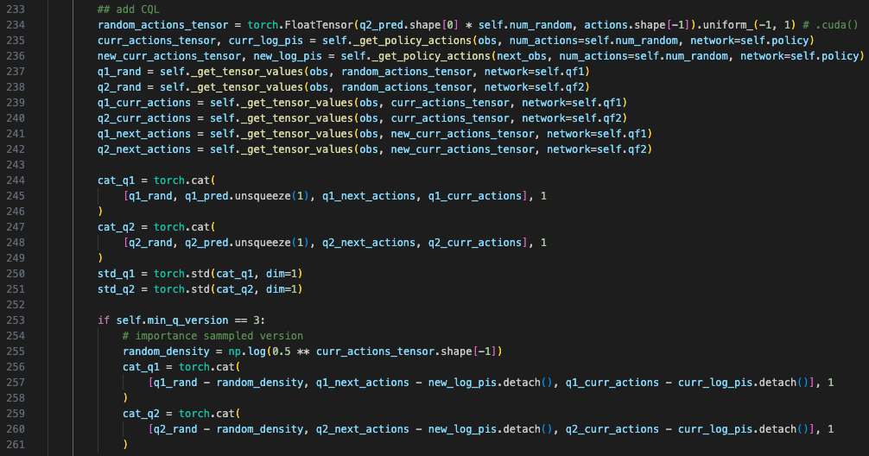
2. Implementation Analysis
- CQL

Slide 16
2. Implementation Analysis
- CQL
Notes:
??

Slide 17
2. Implementation Analysis
- CQL

Slide 18
2. Implementation Analysis
- CQL

Slide 19

2. Implementation Analysis
- SAC

Slide 20
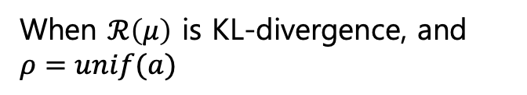
2. Implementation Analysis
- Overall
Paper:
Add CQL(q-value maximization, regularlizer)
When $ℛ\left(μ\right)$ is KL-divergence, and $ρ=unif(a)$

Slide 21
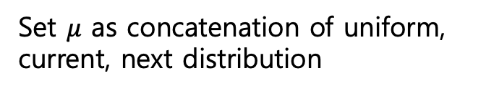
2. Implementation Analysis
- Overall
Implementation:
Just use log-sum-exponential
Set $μ$ as concatenation of uniform, current, next distribution

Slide 22
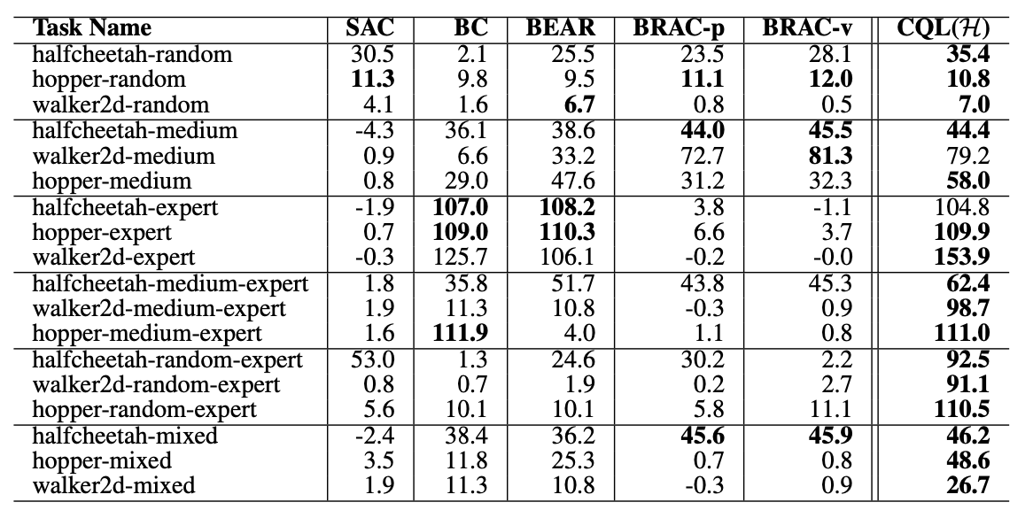
3. Experiment
- Curiosities
1. What is ‘performance’?
2. Why showed as a chart?
3. What if not uniform?
4. Why concatenation with next distribution?

Slide 23



3. Experiment
- Environment Construction
Framework: RLkit, https://github.com/rail-berkeley/rlkit.git
Environment: Used linux docker to meet author’s setting
Visualization: Used Vncserver to see experiment results

Slide 24
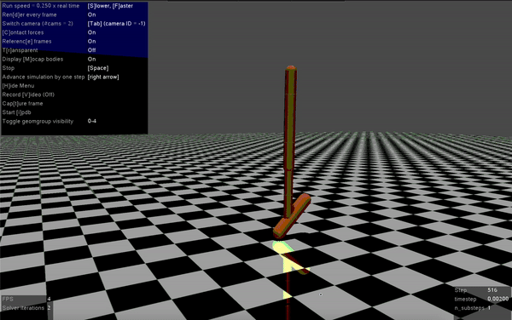
3. Experiment
- Variant Settings
num_epoch: 3000 → 300
num_trains_per_train_loop: 1000 → 50
policy_lr=1e-4, seed=10, lagrange_thresh=5.0, min_q_weight=5.0
hopper-medium →

Slide 25
3. Experiment
- Identifying ‘Performance’
Mean of ‘evaluation/Average Returns’:
walker2d-random: 7.0394
hopper-medium: 82.99945
hopper-medium-expert: 61.9329

Slide 26
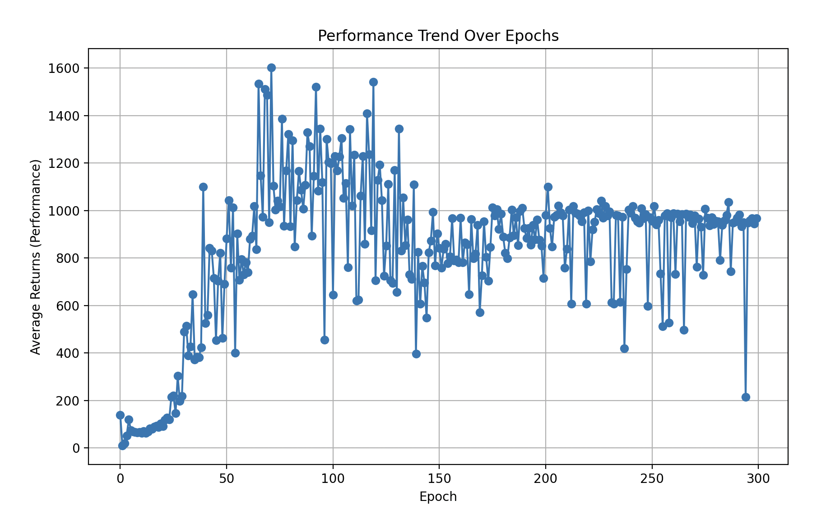
3. Experiment
- Reason of Chart Usage
Average: 82.99945

Slide 27
3. Experiment
- Uniform to Gaussian
What if we believe prior($ρ)$as Gaussian?

Slide 28
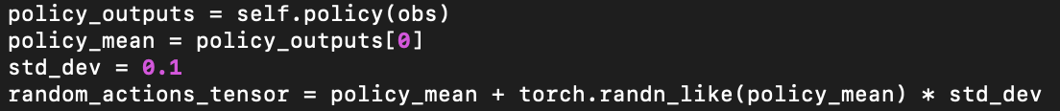
3. Experiment
- Uniform to Gaussian
Gaussian centered as a mean of actions based on current policy.

Slide 29
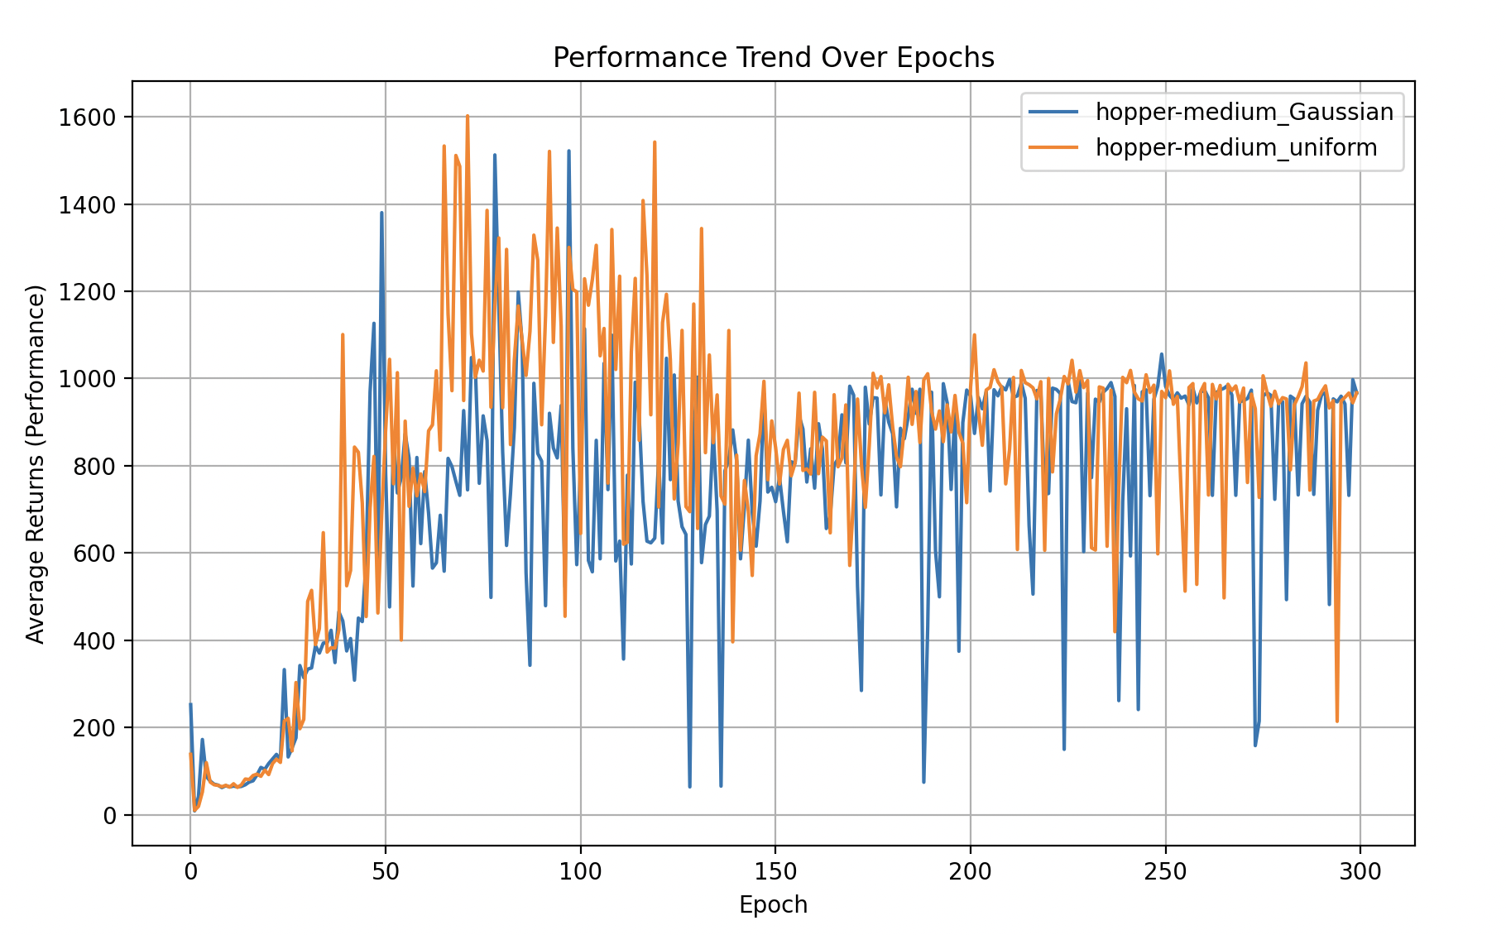
3. Experiment
- Uniform to Gaussian
Score:
hopper-medium with uniform - 82.99945
hopper-medium with Gaussian - 72.5872

Slide 30
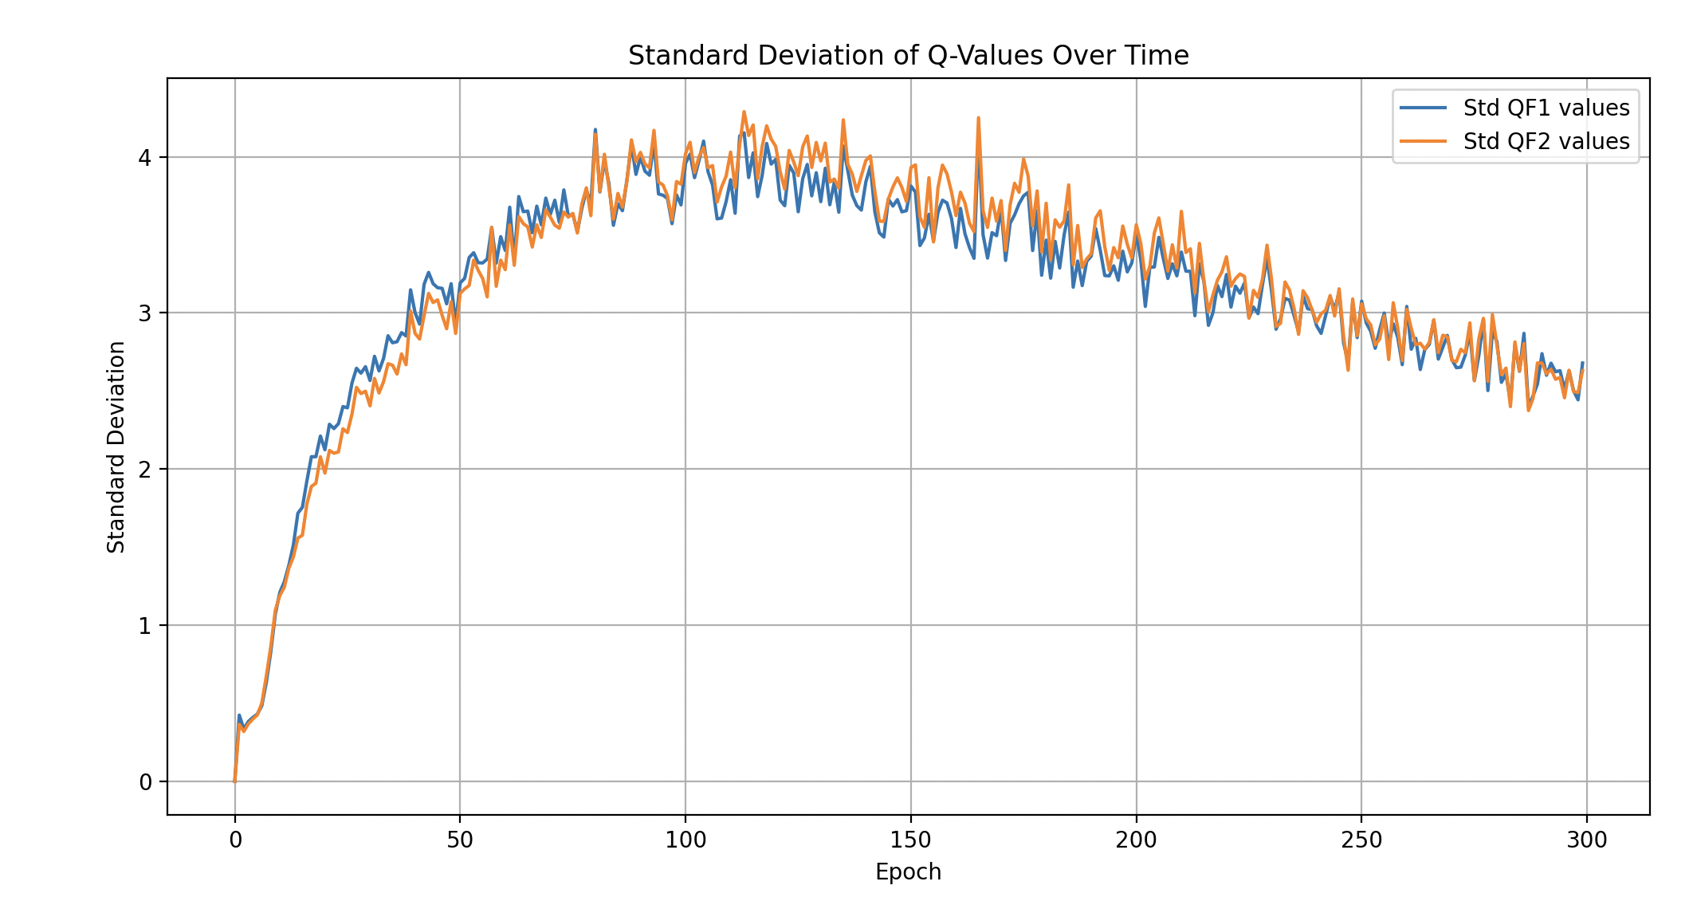
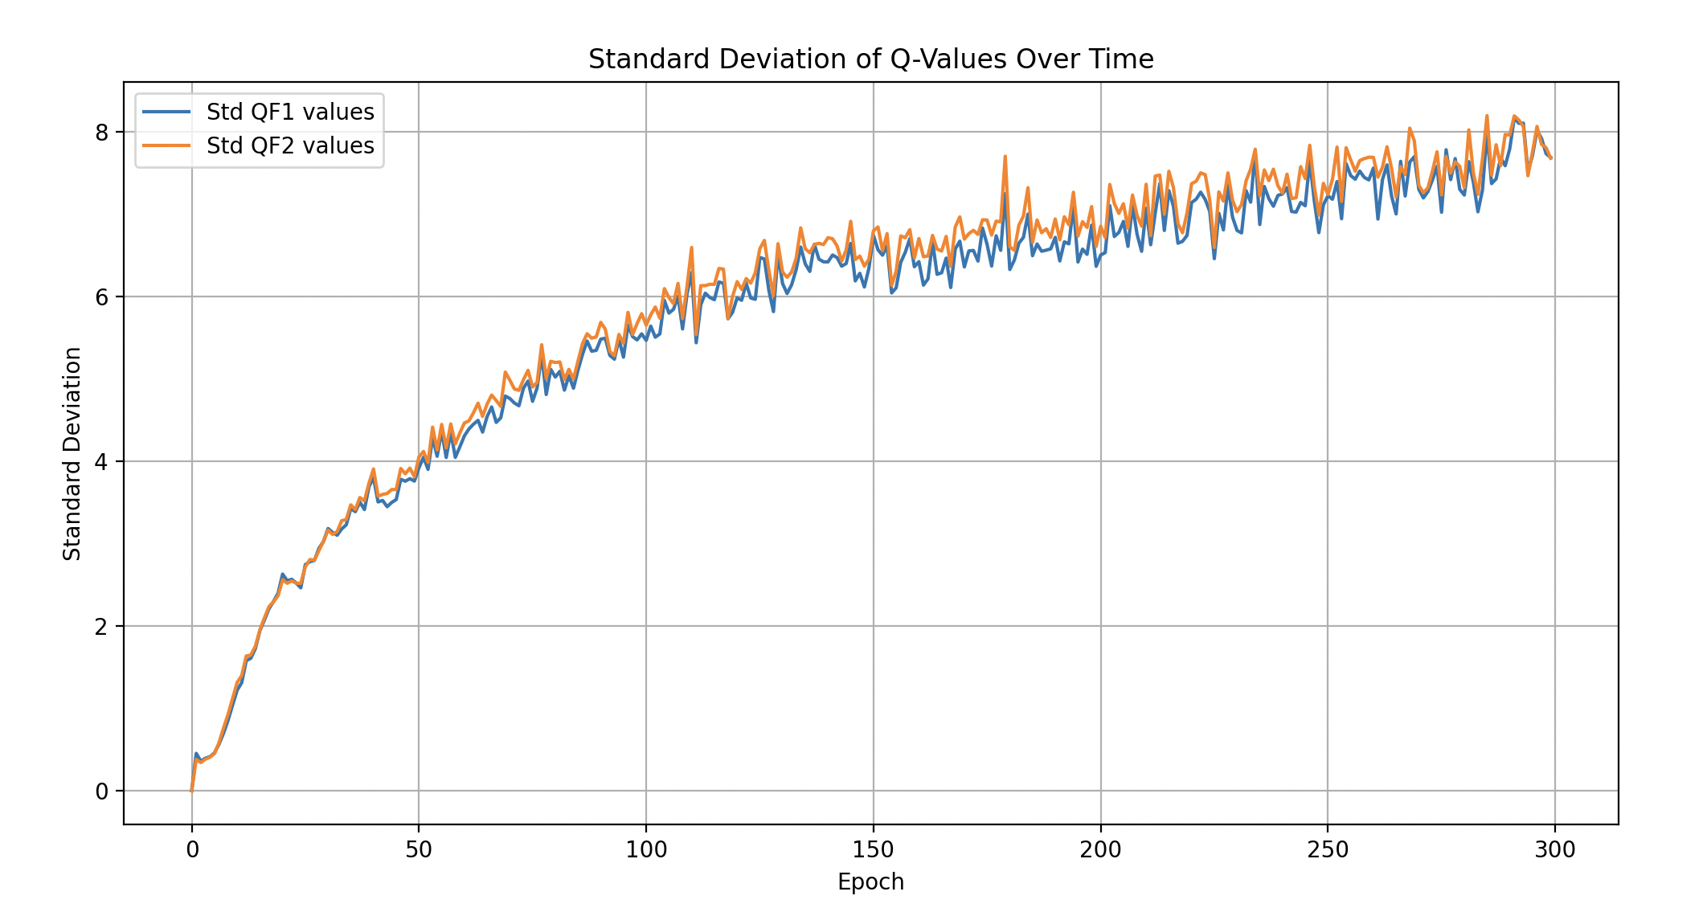
3. Experiment
- Uniform to Gaussian
Gaussian
Uniform
Variance of Q-value decreases over epoch, robust

Slide 31
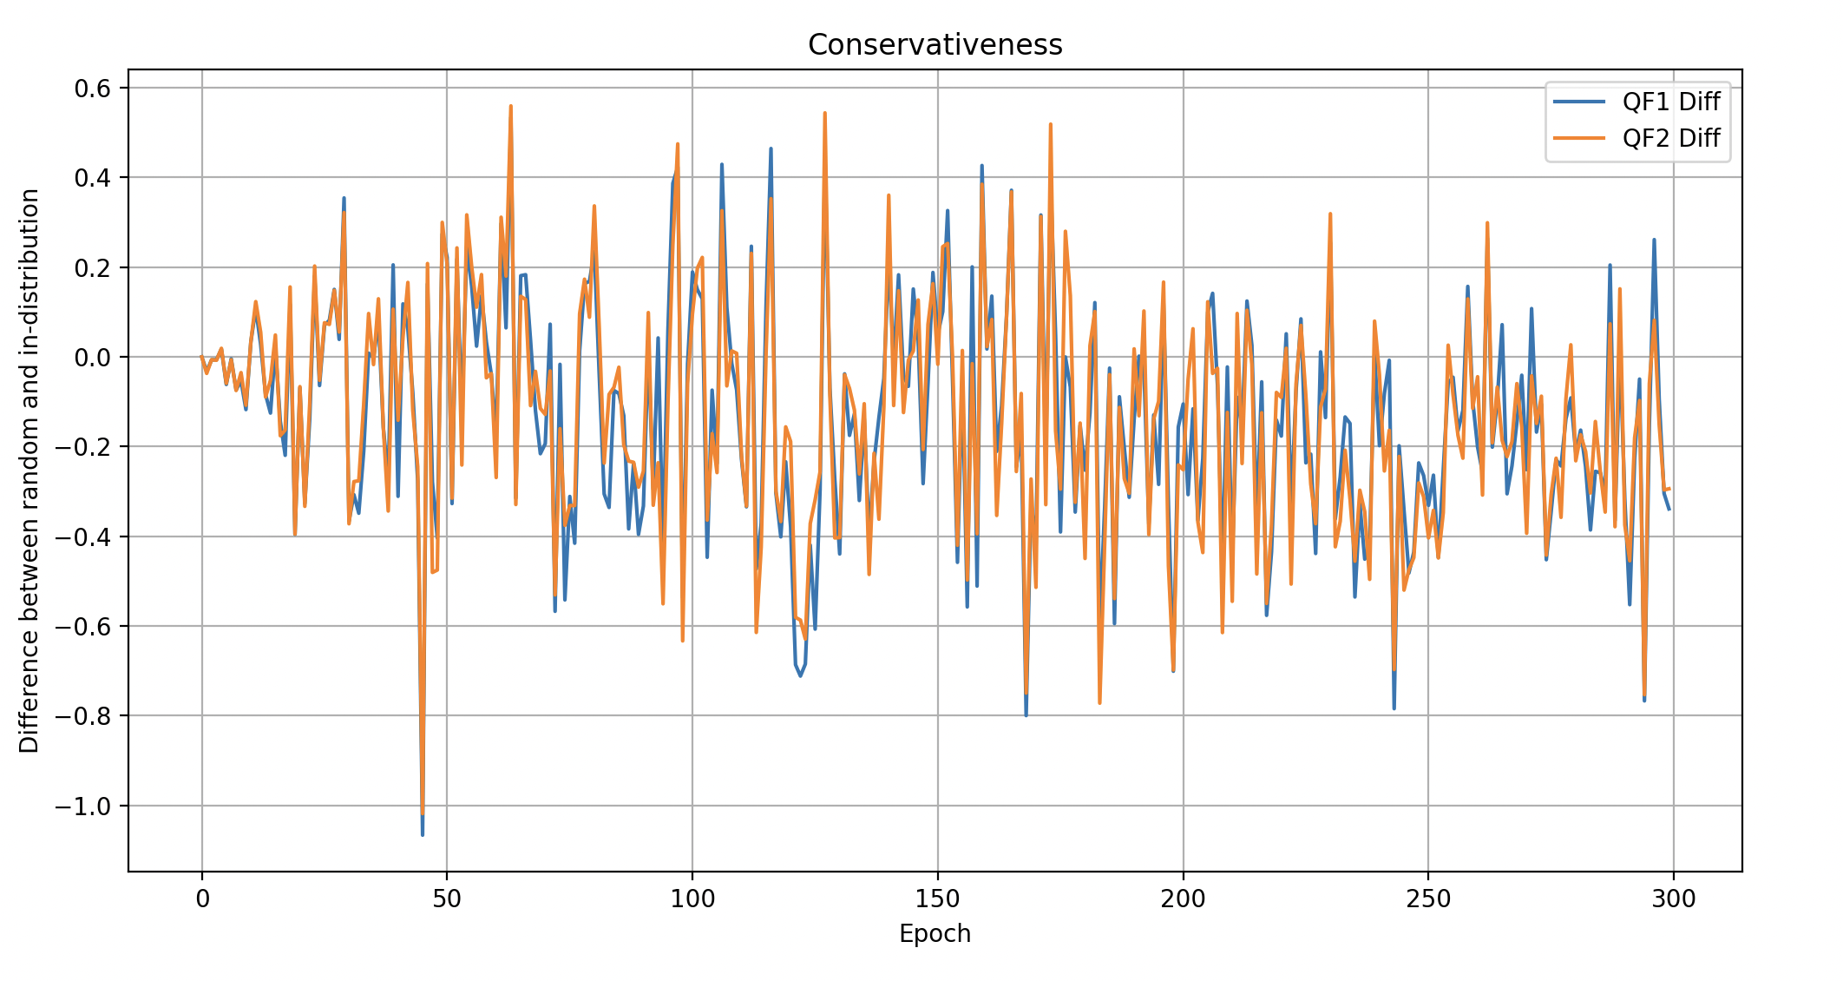
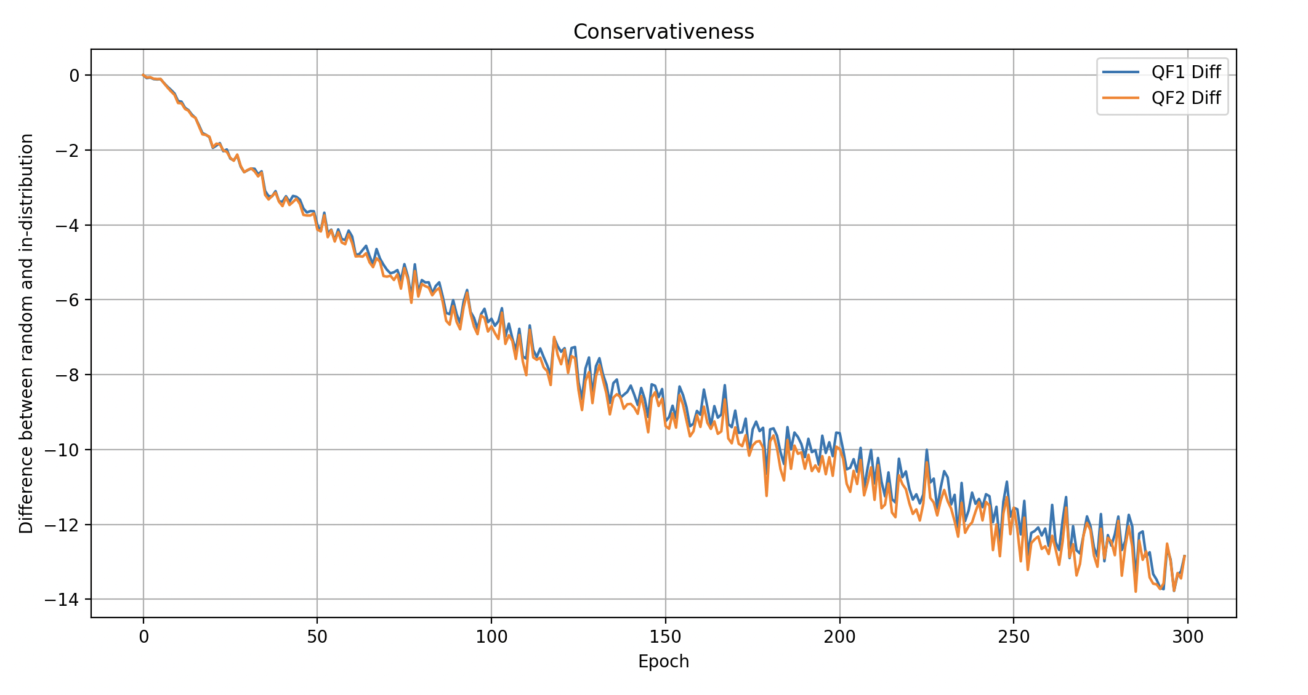
3. Experiment
- Uniform to Gaussian
Gaussian
Uniform
(Q of random) – (Q of in-distribution) > 0
Cannot guarantee conservativeness

Slide 32
3. Experiment
- Choice of Backup

Slide 33
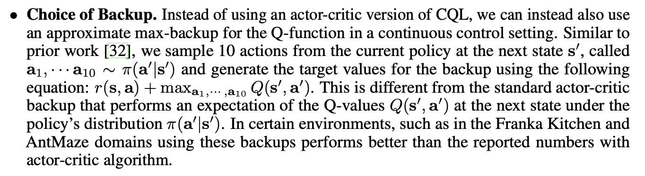
3. Experiment
- Choice of Backup

Slide 34
3. Experiment
- Choice of Backup

Slide 35
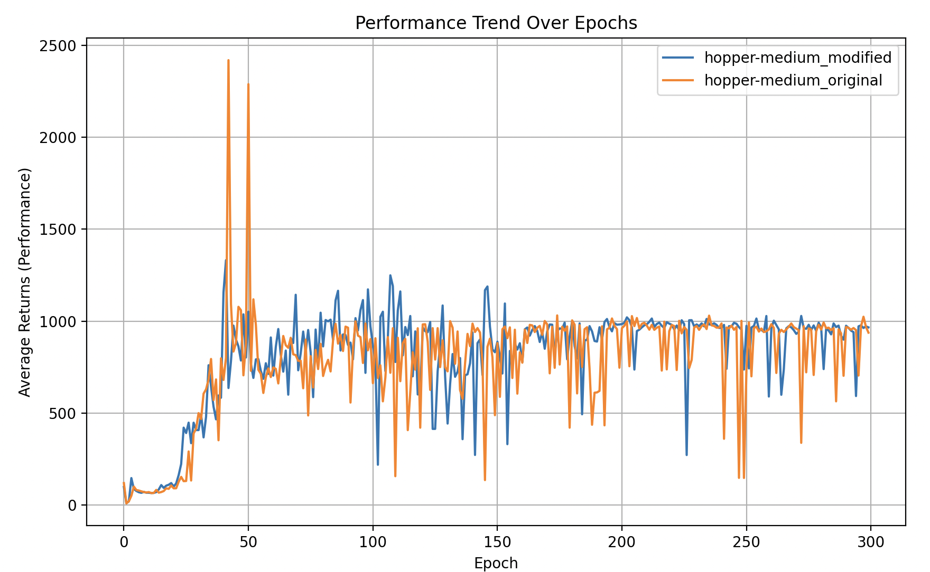
3. Experiment
- Choice of Backup
hopper-medium(min_q_version=2) :
Average score:
modified version – 81.1
original – 77.956

Slide 36
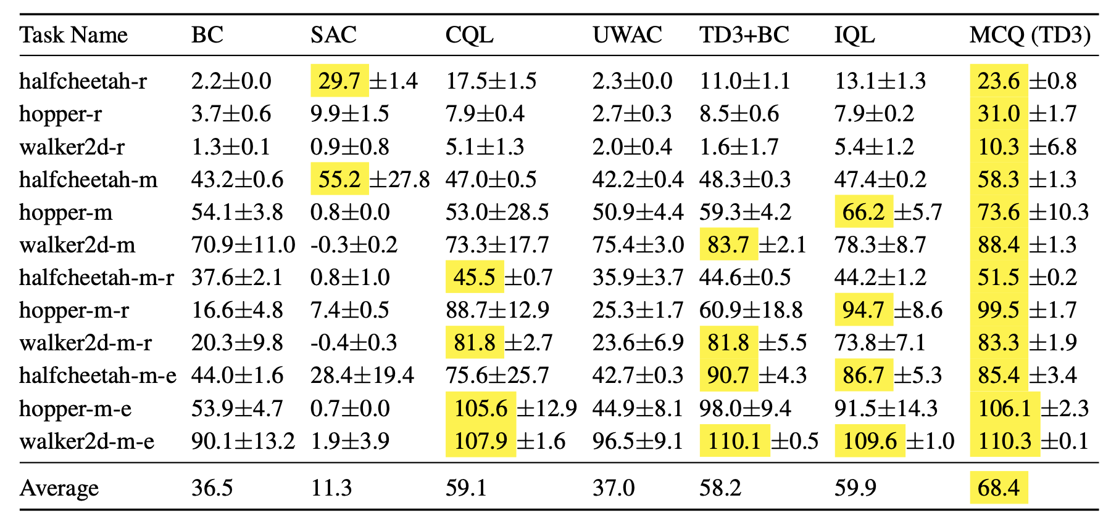
4. Further Research
- Mildly CQL
Mildly Conservative Q-Learning for Offline Reinforcement Learning
-Jiafei Lyu et el, NeurIPS 2022
CQL can be ‘over-conservative’, which can lead to decrease in performance
→ MCQ allows value estimate for OOD action to be higher, as long as they are not excessively optimistic

Slide 37
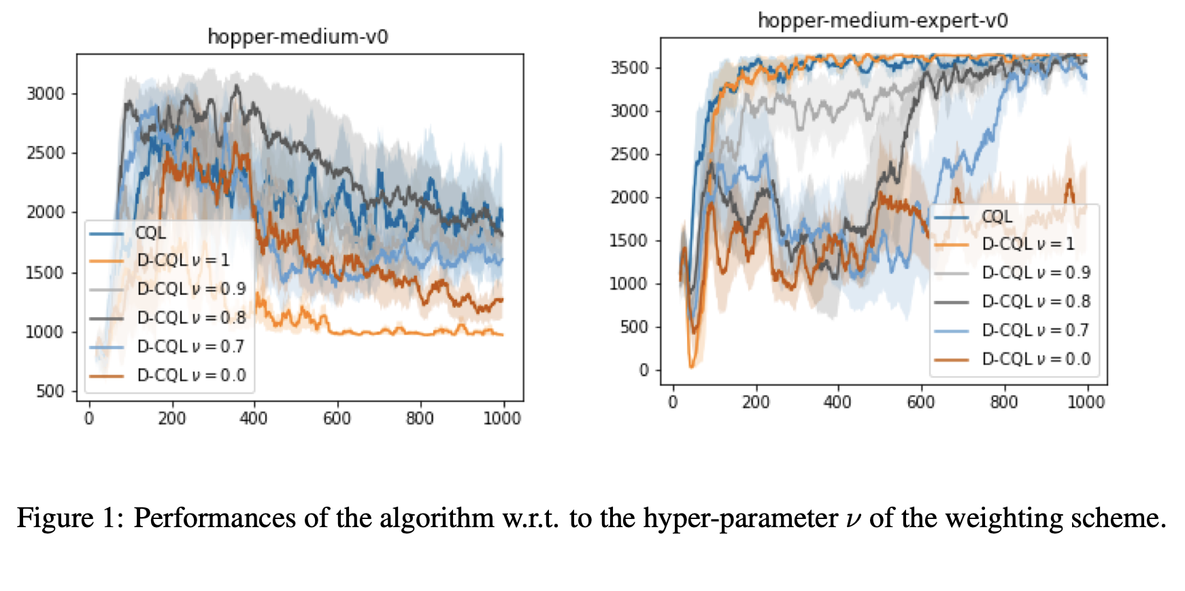
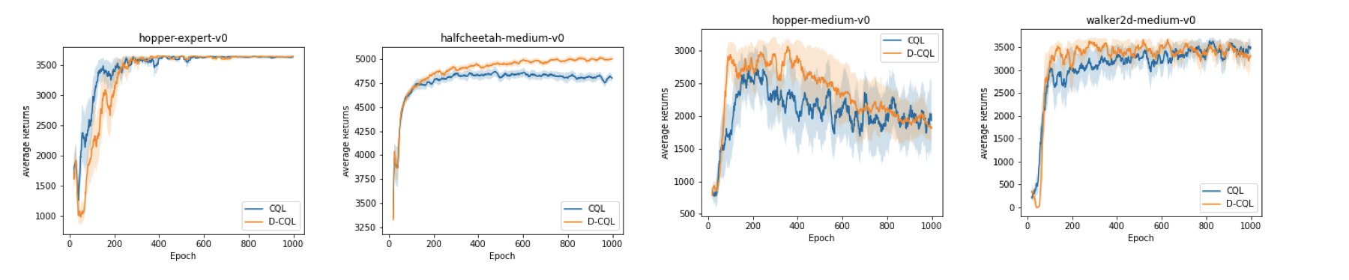
4. Further Research
- Density-CQL
Density Estimation for Conservative Q-Learning
-Paul Daudi et el, 2022
CQL applies a uniform penalty across all out-of-distribution (OOD) actions, regardless of their proximity to the dataset.
→D-CQL uses a density-based approach to adjust the level of penalty based on the estimated likelihood of state-action pairs being in the dataset

Slide 38
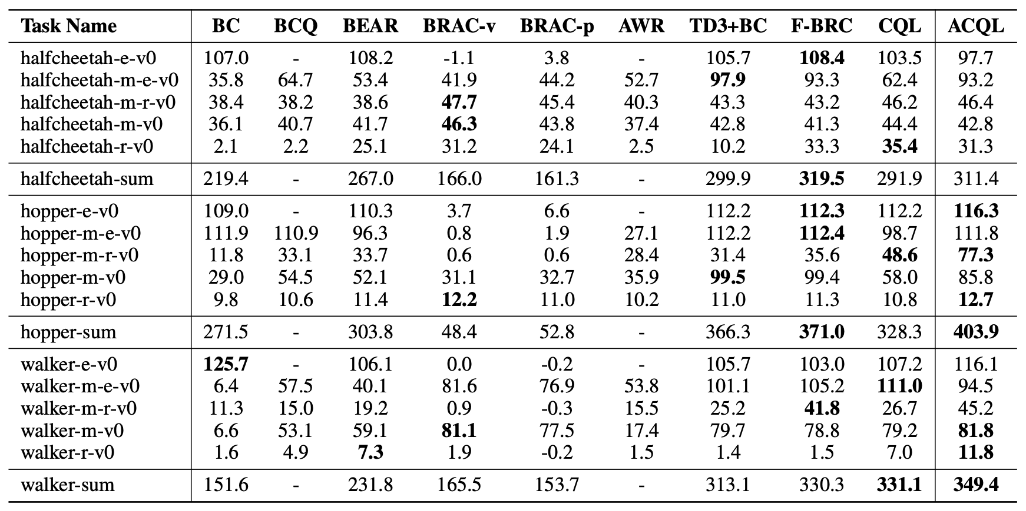
4. Further Research
- Density-CQL
An Adaptive Conservative Q-Learning Framework for Offline Reinforcement Learning – Kun Wu et el, 2023
CQL gives uniform conservatism over all state-action pairs, which can make algorithm overly pessimistic where datasets contain a variety of action qualities
→ ACQL uses adaptive weights that better balances the need to avoid overconservatism

Slide 39
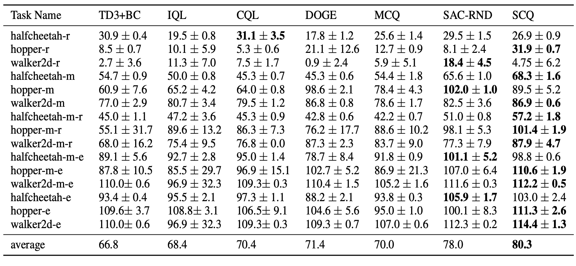
4. Further Research
- Density-CQL
Strategically Conservative Q-Learning
-Yukata Shimizu, Sergey Levine et el. 2024
CQL is overly conservative, since it applies uniform penalties
→ SCQ applies conservatism more strategically by focusing on areas of the action space where generalization is likely to fail

Slide 40


